Slide 1
Predicting Attrition at DDSAnalytics
Garrett Drake
Notes:
Hi ladies and gentlemen my name is Garrett Drake. Thank you so much for being here and allowing me the time to present some factors that help predict employee attrition at your company DDSAnalytics.

Slide 2
Scope of analysis / problem
You (DDSAnalytics executives) are interested in the analysis of factors contributing to employee attrition in talent management given the data that you’ve provided. Furthermore of interest is also predicting employee turnover utilizing this data.
Notes:
Just to refresh, the scope of analysis was that DDSAnalytics was interested in identifying factors that contribute to employee attrition in talent management and further the ability to predict employee turnover using the data that y’all collect and provided.

Slide 3
About the Data and Analysis
870 observations of 35 variables
No missing values
730 people with no attrition, 140 people with attrition for a ratio of 16% Attrition, which is on average with typical business attrition rates of about 18% (cite below)
Due to the high imbalance (proportion) of attrition vs no attrition oversampling was used in the analysis.
The variables that were used in models were scaled
Two separate algorithms, k-NN and Naïve Bayes, were run with the same variables in the model.
https://www.netsuite.com/portal/resource/articles/human-resources/employee-turnover-statistics.shtml
Notes:
Oversampling is the practice of selecting respondents so that some groups make up a larger share of the survey sample than they do in the population

Slide 4
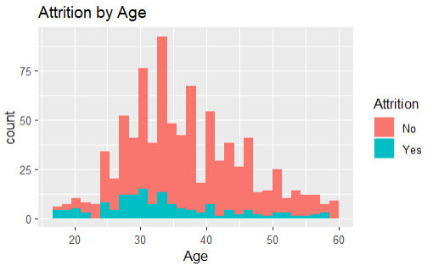
Highest proportion of attrition is at younger ages around 18-21, while highest number of people that leave is around age 30

Slide 5
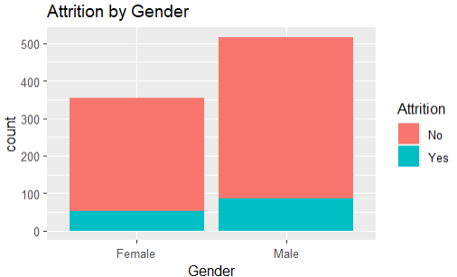
15 % Attrition by Females, and 16.9 % Attrition by Males

Slide 6
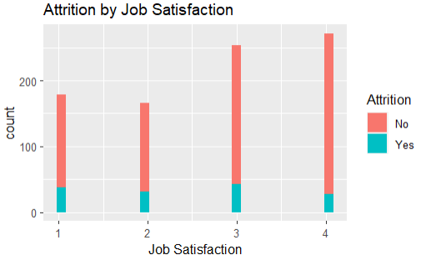
Attrition percentage by group: 1 = 21.2%, 2 = 18.7%, 3 = 16.9%, 4 = 10.3%

Slide 7
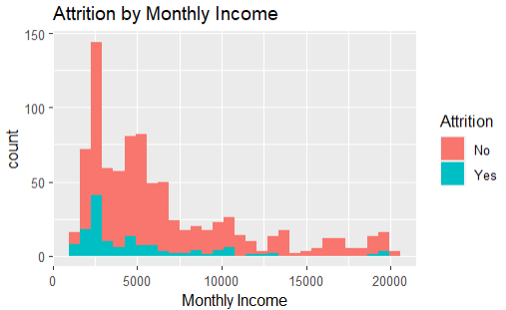
Generally more attrition with lower monthly incomes

Slide 8
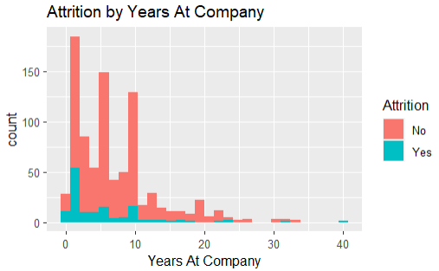
Generally more attrition with lower years at the company.

Slide 9
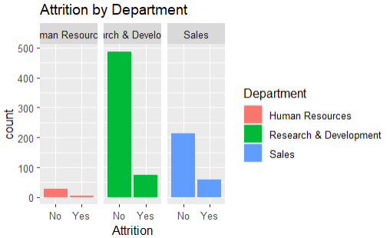
Attrition by Department: HR = 17.1%, R&D = 13.3%, Sales = 21.6%

Slide 10
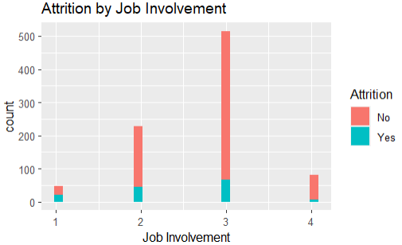
Attrition by involvement: 1 = 46.8%, 2 = 19.3%, 3 = 13%, 4 = 8.6%

Slide 11
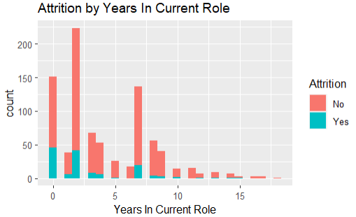
Higher attrition rates with fewer years in the current role

Slide 12
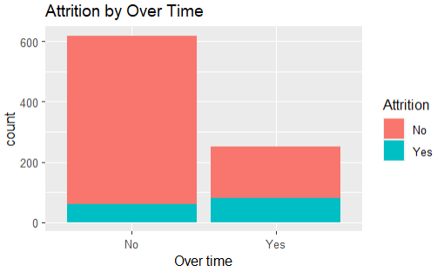
Percent of Attrition by Over time: No = 9.7% , Yes = 31.7%
Notes:
There is a significantly higher percentage of hourly workers that leave the company, possibly due to stress or feeling overwhelmed or something else

Slide 13
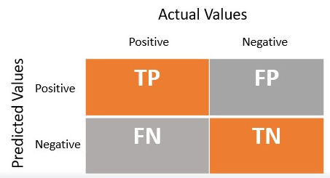
K-nearest neighbors (K-NN) Model
Algorithm where data is classified(predicted) by estimating the likelihood that a data point will become a member of one group or another, i.e. attrition vs no attrition, based on its geospatial location of other variables
Scaling and oversampling was used for the model.
Variables were:
Age, Gender, Job Satisfaction, Monthly Income, Department, Job Involvement, Years in Current Role, Overtime
Accuracy: 82.13%
Sensitivity: 76%
Specificity: 88.83%
Actual Attrition Values
No
Yes
No
Yes
Notes:
Scaling allows the data to be evaluated on the same scale, and since there are so many different variables on different scales this is one of the best ways to optimize K-NN
Accuracy is the number of correctly identified cases divided by the total
Sensitivity is number of True positive divided by true positive plus false negative
Specificity is number of true negatives divided by true negatives pluse false positives

Slide 14
Naïve Bayes Model
Naïve Bayes uses probability that considers each variable independently to estimate the probability that a variable (Attrition) is classified correctly.
Scaling and oversampling was used for the variables in the model, although scaling was not technically necessary, it does not change the outcome predictions
Same variables were:
Age, Gender, Job Satisfaction, Monthly Income, Department, Job Involvement, Years in Current Role
Accuracy: 76.33%
Sensitivity: 75.11%
Specificity: 77.67 %

Slide 15
Conclusions
K-NN model performance with the variables mentioned appeared to perform better across all metrics, accuracy, sensitivity, and specificity.
In regards to age, it appears that proportionally the younger the employee, the higher likelihood they are to leave the company.
As what would be expected, the lower the job involvement the higher likelihood for attrition.
There is a significantly higher percentage of hourly workers that worked over time that leave the company, possibly due to stress or feeling overwhelmed or some other factor
Highest percentage of attrition by department was sales and lowest was R&D
Appears to be a decreasing trend of attrition for number of years worked at the company, i.e. more time at company less likely for attrition
Appears to be a decreasing trend of attrition monthly income, i.e. higher monthly income less likely for attrition

Slide 16
Suggestions
Consider possible interventions for younger age employees
Such as more opportunity for growth in the company
More opportunities for leadership roles, whether it be in management or over projects, etc.
Consider possible interventions to increase job involvement
Such as: flexibility of work schedule
Working as part of a team
Holding regular social gatherings
Promoting mentorship program / environment
Asking for employee feedback

Slide 17
Questions?
Contact info
Garrett Drake via email

